Slide 1
Automated spatiotemporal annotation of sound objects in a scene
COMP.SGN.250 Signal Processing Innovation Project
Final Presentation
Einari VAARAS
Kalle LAHTINEN
Mehmet AYDIN

Slide 2
Introduction
Audio streams, such as broadcast news, documentaries and personal videos contain sounds from a wide variety of sound sources
These streams include detectable audio events of interest, such as speech, music or sounds of animals
Beside the detection of sound event presence there is a need for detecting the direction of arrival (DOA) of the detected sound event. For such cases Deep Learning methods are often used but requires annotated data which is laborious and difficult to do reliably
The aim is to explore the possibility of automatically annotating spatial and temporal dimensions of sound objects detected in an audio stream with the help of a 360-degree

Slide 3
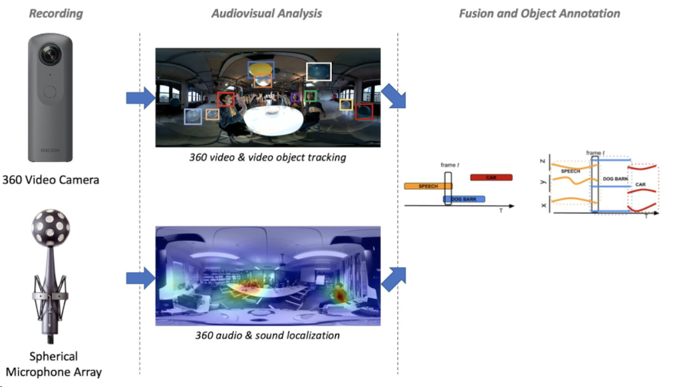

Slide 4
Introduction
Studying object detection methods for 360-degree video data
Determining and defining the scenes to be recorded
Recording spatiotemporal scenes with a 360-degree camera and integrated 360-degree microphone
Applying object detection to the video recording
Extracting temporal object detections and their locations from the video recording
Formulating spatiotemporal labels for the audio data by combining video and audio detections

Slide 5
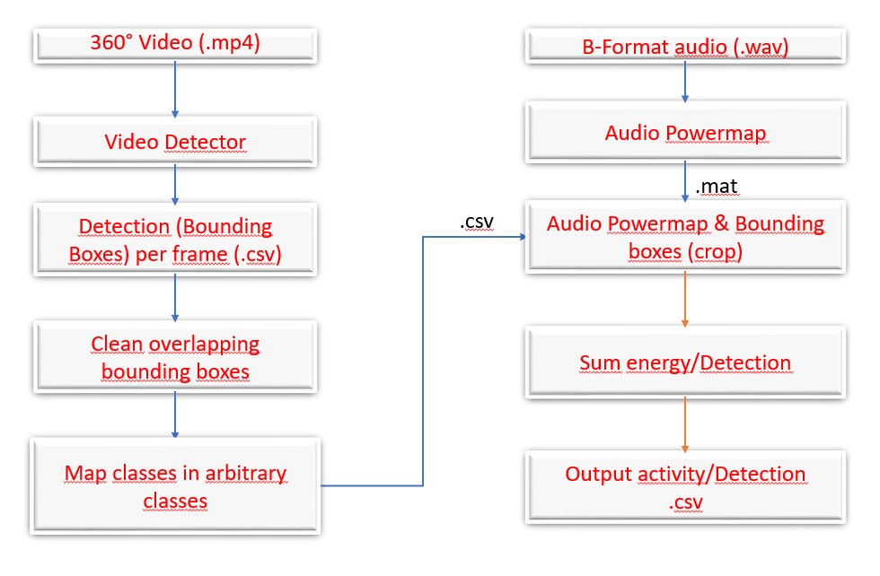
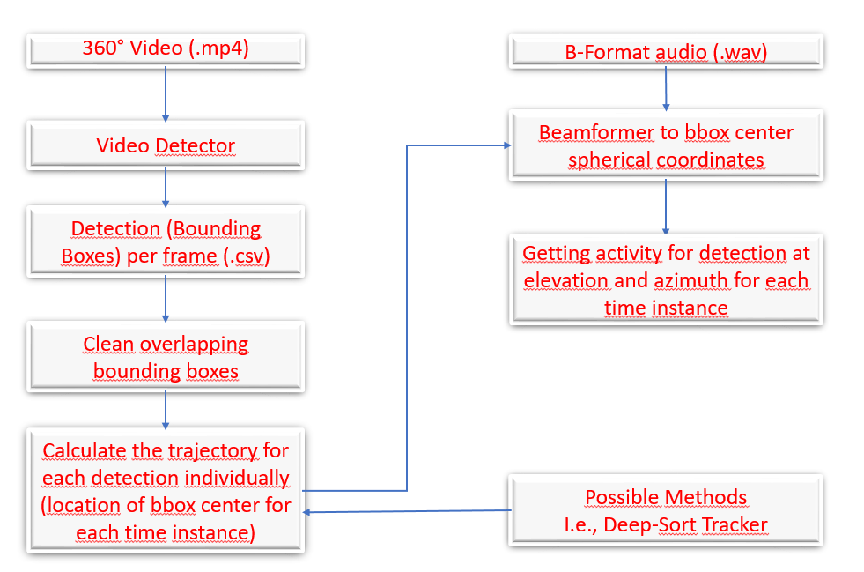
Block Diagram of the work flow
Pipeline version 1
Pipeline version 2

Slide 16
Deep SORT
Deep-Sort is a traditional single-hypothesis multi-target tracking method using recursive Kalman filtering and frame-by-frame data correlation.
Deep-Sort adopts the fusion metric that combining the distance of predicted position and the observed position in the Markov space and the cosine distance of the apparent feature between the bounding boxes in the Kalman filter.

Slide 17
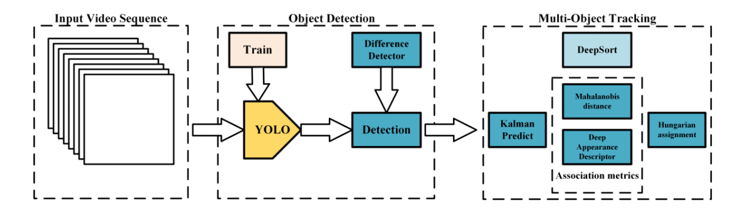
Figure : The workflow of real-time detection and tracking [1]

Slide 18
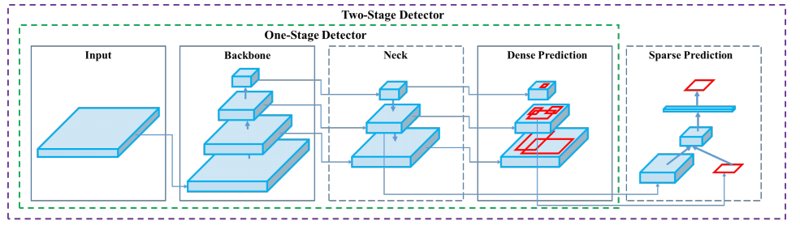
Figure : Architecture of object detection of YOLOv4 [2]
Input: {image, patches, image pyramid}
Backbone: {VGG16, ResNet50, ResNeXt-101, Darknet53}
Neck:
Head:
Dense Prediction: {RPN, YOLO, SSD, Retina-Net, FCOS}
Sparse Prediction: {Faster R-CNN, R-FCN} [2]

Slide 19
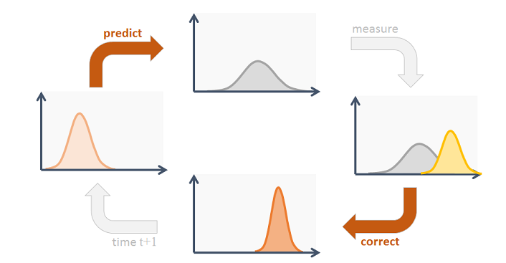
Kalman Filter
Source:https://www.codeproject.com/Articles/865935/Object-Tracking-Kalman-Filter-with-Ease

Slide 20
References
[1] Xu Zhang, Xiangyang Hao, Songlin Liu, Junqiang Wang, Jiwei Xu, Jun Hu, "Multi-target tracking of surveillance video with differential YOLO and DeepSort," Proc. SPIE 11179, Eleventh International Conference on Digital Image Processing (ICDIP 2019), 111792L (14 August 2019); doi: 10.1117/12.2540269
[2] Alexey Bochkovskiy,Chien-Yao Wang,Hong-Yuan Mark Liao, "YOLOv4: Optimal Speed and Accuracy of Object Detection ",2020

